Slide 1
Text Analytics
Tomas Karpati tc.datascience@gmail.com
054-2002430

Slide 2

Text Analytics

Slide 3
Uses of Text Analytics
Text Classification
Sentiment Analysis
Natural Language Processing (NLP)
Text summarization
Intention (context) analysis
Speech to Text translation
Bots (automation robots)

Slide 4
Main Concepts
Corpus: Text or group of texts
Tokens: words, numbers or punctuation
Monograms: unique tokens
Bigrams: token pairs (two words)
Stopwords: the most common words in a language and are usually filtered out before processing of text data
Word cloud: a graphical representation of the common words

Slide 5
Text Analytics Methodologies
Language Identification: which language?
Tokenization: the process of breaking down text document apart into those pieces. In some languages it’s not possible without the use of machine learning techniques (e.g. Chines, Japanese)
Sentence Breaking: detection of full sentences, appropriate breaking (not every point indicates the end of the sentences - Dr. X)

Slide 6
Text Analytics Methodologies
Part of Speech (PoS) Tagging: role of each token in the sentence: noun, verb, adjective, etc
Chunking: reconstructing the sentence using the tags we created in PoS tagging
Syntax Parsing: is the phase of context extraction from each sentence. It’s the most computing intensive phase.
Sentence Chaining: the search for related sentences.

Slide 7
Importing Text for Processing
Document formats:
Word
PDF
Text files
Create a dataframe on which documents are represented in a column, and include the title, classes, etc. also as columns

Slide 8
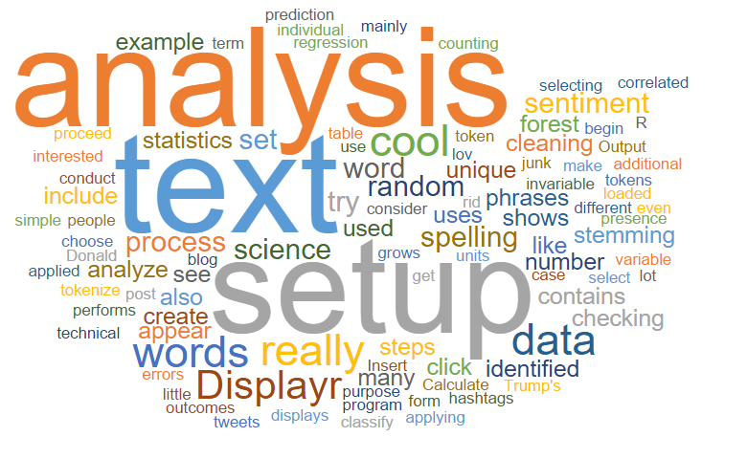
EDA on Text

Slide 9
EDA on Text
Exploratory Data Analysis on Text
Descriptive analysis:
Number of corpuses
Number of classes
Word counts
Bag-of-words
Graphical analysis:
Word Cloud

Slide 10
Word Preprocessing
Conversion of Uppercase to Lowercase
Eliminating punctuation marks
( . , ; ‘ “ ! # ? ! …)
Eliminate stopwords
Bag-of-words (token frequencies)

Slide 11
Stemming and Lemmatization
Some words are highly correlated and even may have the same meaning. Those words may be redundant and have to be treated.
Examples are:
organize, organizes, organizing -> organiz
democracy, democratic, and democratization -> democra

Slide 12
Stemming and Lemmatization
Stemming: a crude heuristic process that chops off the ends of words in the hope of achieving this goal correctly most of the time
Lemmatization: a tool from Natural Language Processing which does full morphological analysis to accurately identify the lemma for each word.

Slide 13
Stemming and Lemmatization
Some problems when using Stemming: combining words that may have a different mean depending on the context
university/universe
volume/volumes
marketing/markets
absorbency/absorbent
abandon/abandonment

Slide 14

Unsupervised Text Analysis

Slide 15
Unsupervised Text Analysis
Get the corpus
Preprocess the corpus
Use Cosine distance to calculate the distances between each token
Use some cluster algorithm to classify the text (hierarchical clustering is mostly used)
Try other algorithms like k-means and PCA
Compare the models

Slide 16
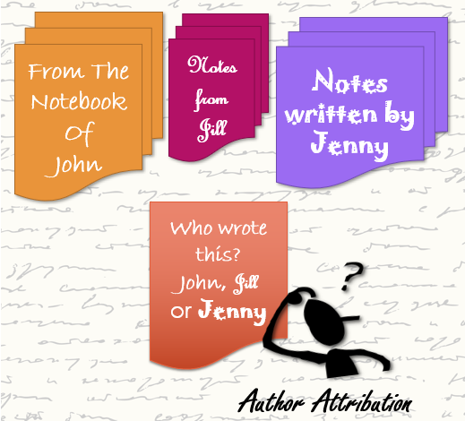
Supervised Text Classification

Slide 17
Supervised Text Classification
Get the training corpus
Preprocess the corpus
Generate a bag-of-words
Apply a classification algorithm
Check the feature importance
Check the AUC of the prediction
Use an unseen corpus to check the reliability of the prediction model

Slide 18
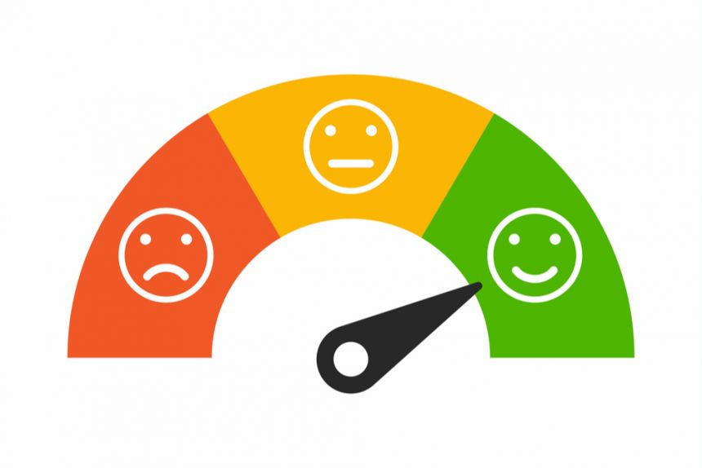
Sentiment Analysis

Slide 19
Sentiment Analysis
Sentiment analysis is the analysis of text to extract subjective information.
Used to capt the sentiment of the public about a product, a change in price, a brand or a pearson (eg. in politics, employees, etc)
The data is mostly extracted from social media, but may be used on any text
Can be used to track trends in sentiment over time

Slide 20
Sentiment Analysis
There are words with express agreement, positivity and hope and are considered “positive” words
Other words express disagreement, negativity and despair and are considered as “negative” words
Each word is given a score between -1 to +1. Neutral words recieve zero. The total sentiment score of a text is calculated using “log odds ratios” of the scores of the words in the text.

